Slide 1
카드생성
cardShape[]={“스페이드”,“클로버”,“다이아”,“하트”}
cardNumber[]={“A”,“2”,“3”,..,“10”,“J”,“Q”,“K”}
시작
deck[]
i=0
i ++
i<52
YES
deck[i]=i
NO
종료

Slide 2
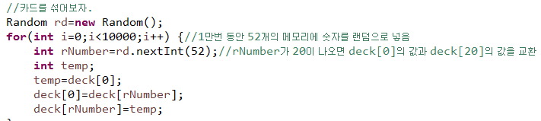
카드섞기
시작
i=0
i ++
i<10000
YES
rand=51이하랜덤수
temp=deck[0]
deck[0]=deck[rand]
deck[rand]=temp
NO
시작

Slide 3
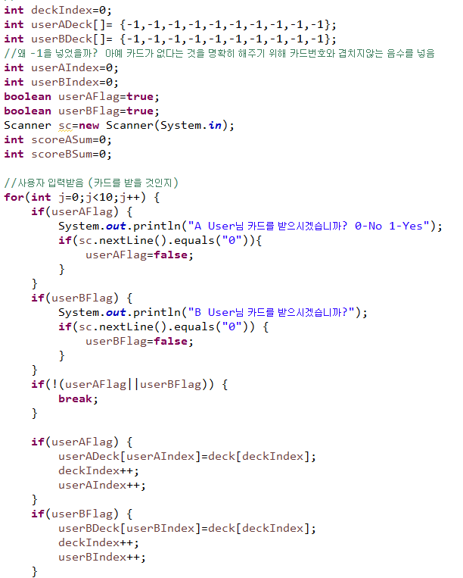
게임진행

Slide 4
시작
deckIndex=0
userADeck[]={-1,…,-1}(10개)
userBDeck[]={-1,…,-1}(10개)
userAindex=0
userBindex=0
userAFlag=true
userBFlag=true
j=0
j<10
YES
userAFlag= true
YES
p(“A User님 카드를 받으시겠습니까? 0-No 1-Yes”)
sc.nextLine().equals(“0”)
YES
userAFlag=false
NO
NO
NO
userBFlag= true
YES
p(“B User님 카드를 받으시겠습니까? 0-No 1-Yes”)
sc.nextLine().equals(“0”)
YES
userBFlag=false
NO
NO
!(userAFlag|| userBFlag)
YES
j ++
break
NO
userAFlag= true
YES
userADeck[userAIndex]=deck[deckIndex]
deckIndex++
userAIndex++
NO
userBFlag= true
YES
userBDeck[userBIndex]=deck[deckIndex]
deckIndex++
userBIndex++
NO
받은 카드 출력
승패결정

Slide 5
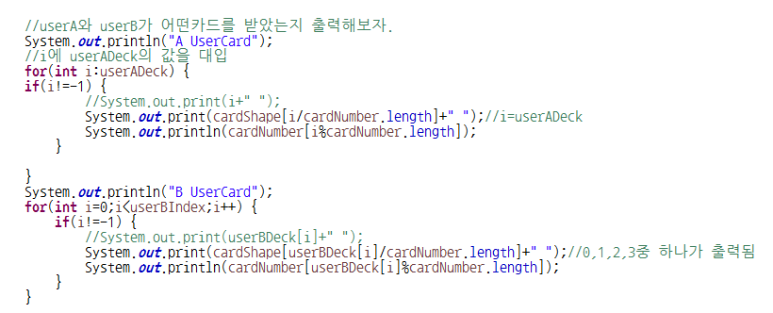
받은 카드 출력
시작
시작
p(“A UserCard”)
i=0
p(“B UserCard”)
i=0
NO
i
=userAIndex
i++
NO
i
<userBIndex
i++
YES
YES
i !=-1
NO
i !=-1
NO
YES
YES
p(cardShape[i/cardNumber.length])
p(cardNumber[i%cardNumber.length])
p(cardShape[userBDeck[i]/ cardNumber.length])
p(cardNumber[userBDeck[i]% cardNumber.length])
B UserCard 출력
점수계산

Slide 6
카드 1장 받기
시작
deck[] ={}
deckIndex=0
p1Deck[]= {-1,-1,-1,-1,-1,-1,-1,-1,-1,-1}
Index=0,p1Flag=true
p1Flag==true
NO
YES
입력==0
NO
p1Flag=false
p1Flag==true
NO
YES
p1Deck[p1Index]=deck[deckIndex];
deckIndex++;
p1Index++;
시작

Slide 7
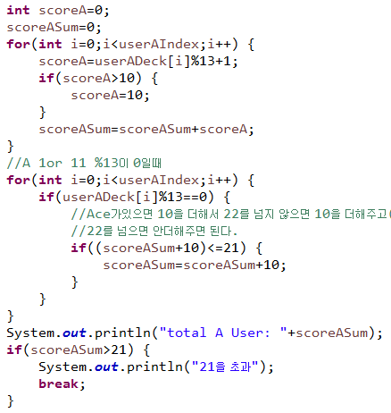
점수계산scoreA
시작
scoreA=0
scoreASum=0
i=0
NO
i<userAIndex
i++
YES
scoreA=userADeck[i]%13+1
scoreASum=scoreASum+scoreA
scoreA>10
NO
YES
i++
scoreASum<=21
NO
scoreA=10
YES
NO
scoreASum=scoreASum+10
i<userAIndex
YES
p(“total A User:”+scoreASum)
i<userAIndex [i]%13==0
NO
scoreASum>21
NO
scoreB
YES
YES
p(“21을 초과”)
승패결정

Slide 8
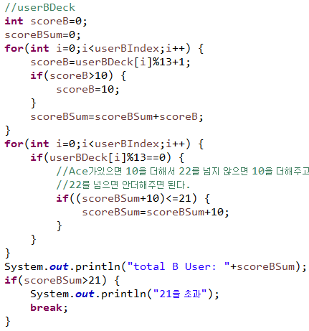
점수계산scoreB
시작
scoreB=0
scoreBSum=0
i=0
NO
i<userBIndex
i++
YES
scoreB=userBDeck[i]%13+1
scoreBSum=scoreBSum+scoreB
scoreB>10
NO
YES
i++
scoreBSum<=21
NO
scoreB=10
YES
NO
scoreBSum=scoreBSum+10
i<userBIndex
YES
p(“total A User:”+scoreBSum)
i<userBIndex [i]%13==0
NO
scoreBSum>21
NO
게임진행
j++
YES
YES
p(“21을 초과”)
승패결정

Slide 9
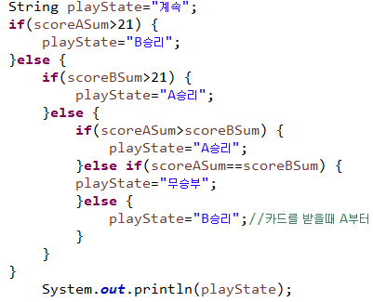
승패
시작
playState=“계속”
scoreASum>21
YES
playState=“B승리”
NO
scoreBSum>21
YES
playState=“A승리”
NO
scoreASum> scoreBSum
YES
playState=“A승리”
NO
scoreASum== scoreBSum
YES
playState=“무승부”
NO
playState=“B승리”
p(playState)
종료

Slide 10
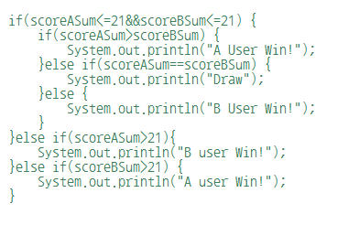
승패
시작
scoreASum<=21
&&
scoreBSum<=21
NO
YES
scoreASum>scoreBSum
NO
scoreASum==scoreBSum
NO
p(“B User Win!”)
YES
YES
p(“A User Win!”)
p(“Draw”)
scoreASum>21
NO
scoreBSum>21
NO
종료
YES
YES
p(“B User Win!”)
p(“A User Win!”)

